Slide 1
Software Design

Slide 2
What is it?
Design is a meaningful engineering representation of something that is to be built.
It can be traced to a customer’s requirements and at the same time assessed for quality against a set of predefined criteria for “good” design.
In the software engineering context, design focuses on four major areas of concern: data, architecture, interfaces, and components.

Slide 3
Why is it important?
You wouldn’t attempt to build a house without a blueprint, would you? You’d risk confusion, errors, a floor plan that didn’t make sense, windows and doors in the wrong place . . . a mess. Computer software is considerably more complex than a house; hence, we need a blueprint—the design

Slide 4
Why is it important?
Design is the place where quality is fostered in software engineering as it provides us with representations of software that can be assessed for quality.
Design is the only way that we can accurately translate a customer's requirements into a finished software product or system.
Software design serves as the foundation for all the software engineering and software support steps that follow.
Without design, we risk building an unstable system—one that will fail when small changes are made; one that may be difficult to test; one whose quality cannot be assessed until late in the software process, when time is short and many dollars have already been spent.

Slide 5
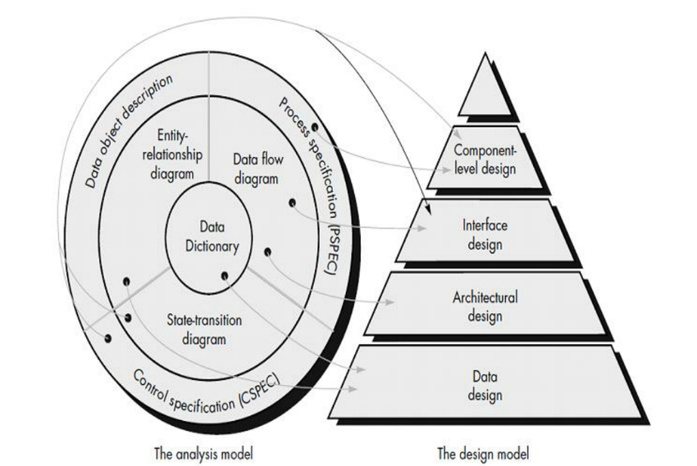

Slide 6
Data Design
The data design transforms the information domain model created during analysis into the data structures that will be required to implement the software.
The data objects and relationships defined in the entity relationship diagram and the detailed data content depicted in the data dictionary provide the basis for the data design activity.
Part of data design may occur in conjunction with the design of software architecture.
More detailed data design occurs as each software component is designed

Slide 7
Architectural Design
The architectural design defines the relationship between major structural elements of the software, the “design patterns” that can be used to achieve the requirements that have been defined for the system, and the constraints that affect the way in which architectural design patterns can be applied.

Slide 8
Interface Design
The interface design describes how the software communicates within itself, with systems that interoperate with it, and with humans who use it.

Slide 9
Component Level Design
Data, architectural, and interface design must be translated into operational software. To accomplish this, the design must be represented at a level of abstraction that is close to code. Component-level design establishes the algorithmic detail required to manipulate data structures, effect communication between software components via their interfaces, and implement the processing algorithms allocated to each component.

Slide 10




DESIGN CONCEPTS

Slide 11
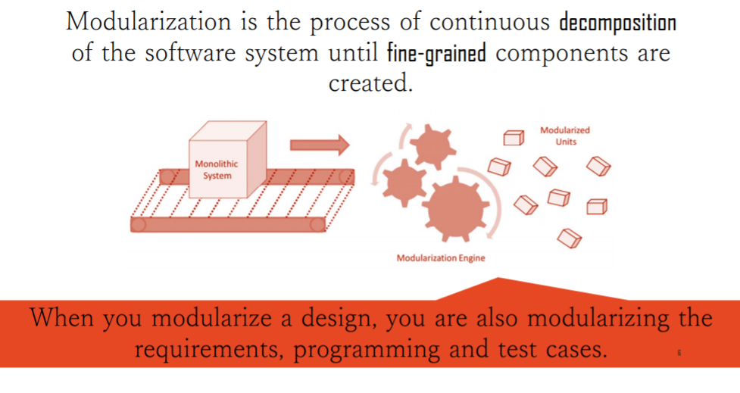
Modularization

Slide 12
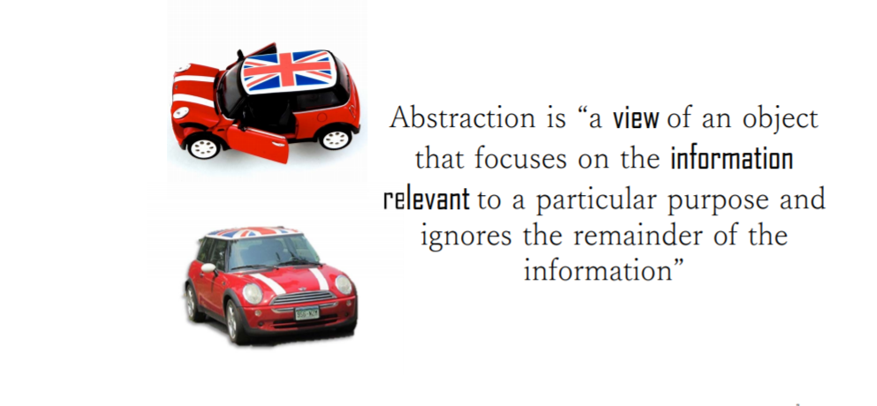
Abstraction

Slide 13
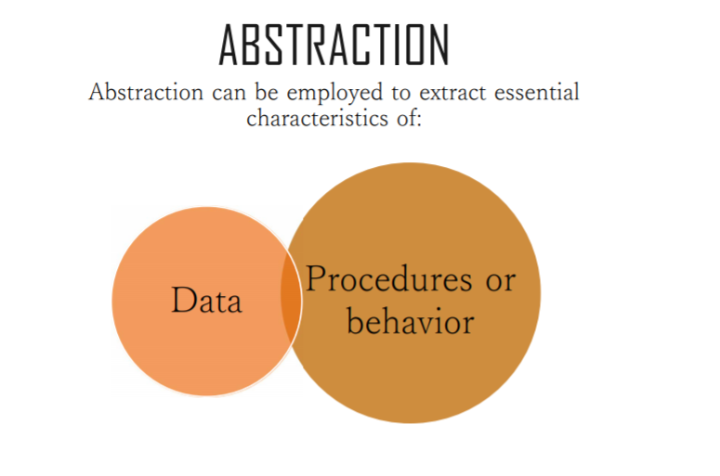

Slide 14
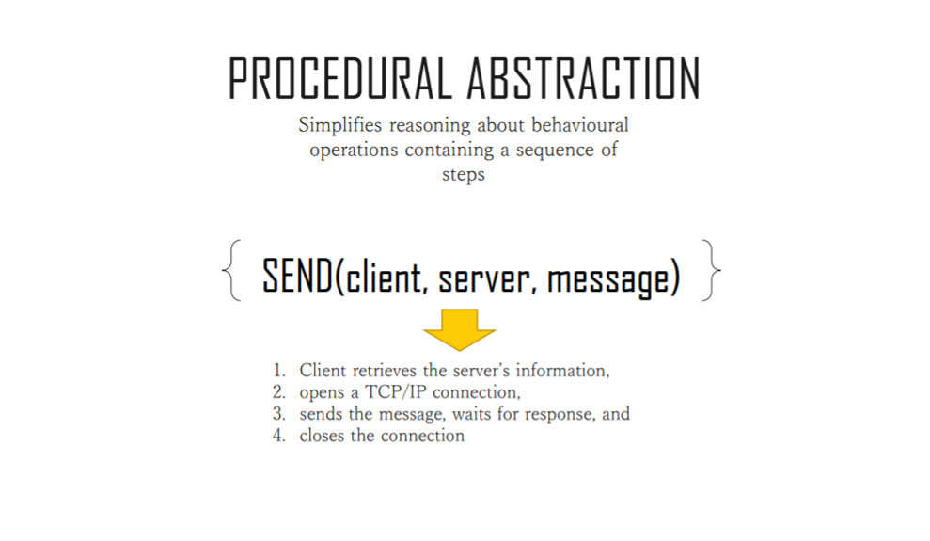

Slide 15
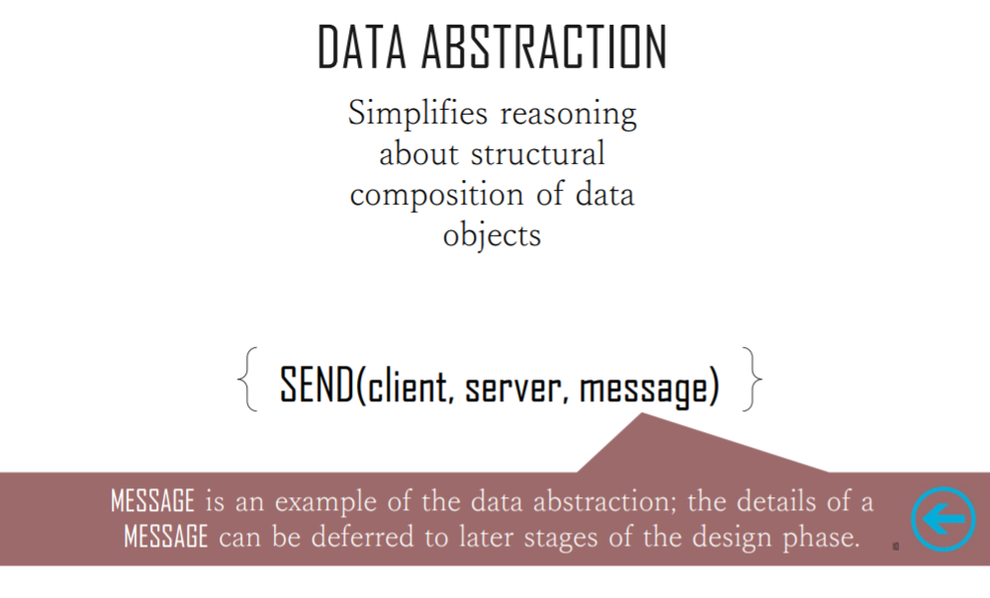

Slide 16
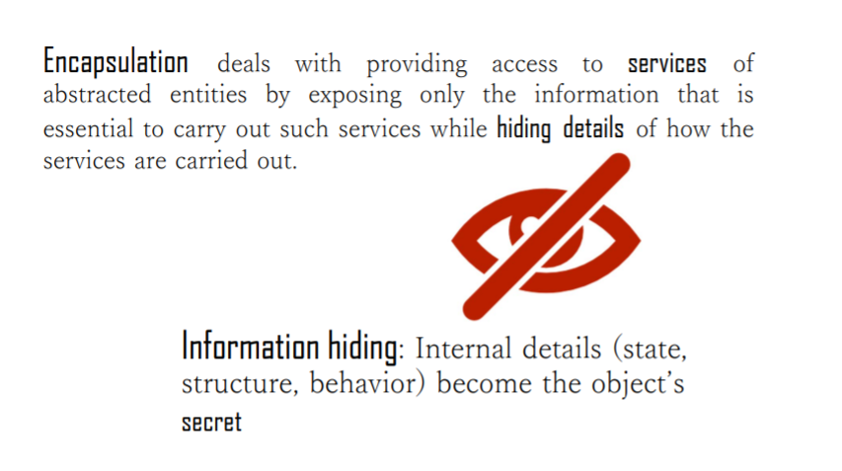
Encapsulation

Slide 17
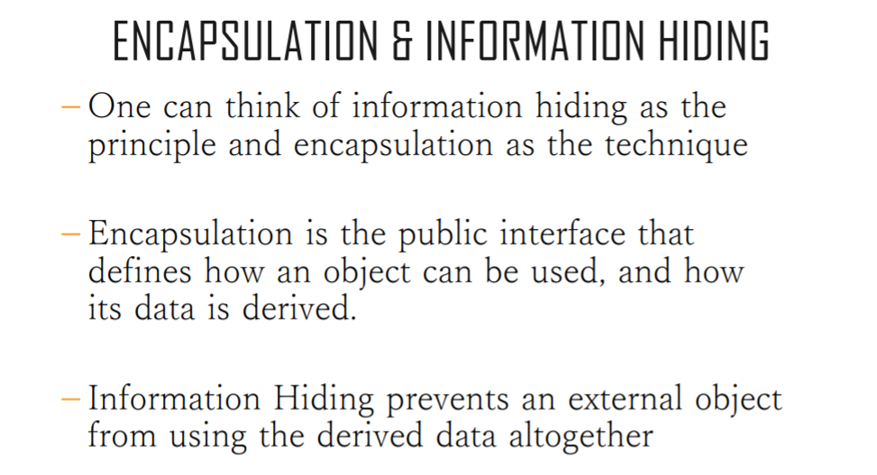

Slide 18

Information Hiding
Information (data and procedure) contained within a module should be inaccessible to other modules that have no need for such information.
Hiding defines and enforces access constraints to both procedural detail within a module and any local data structure used by the module
Modules should be specified and designed so that information (procedure and data) contained within a module is inaccessible to other modules that have no need for such information.
Hiding implies that effective modularity can be achieved by defining a set of independent modules
that communicate with one another only that information necessary to achieve software function.
This enforces access constraints to both procedural (i.e., implementation) detail and local data structures.

Slide 19
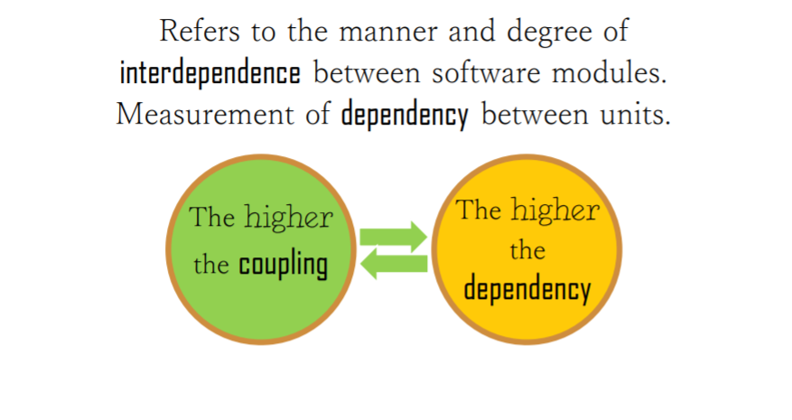
Coupling

Slide 20
COUPLING:
DEGREE OF DEPENDENCE AMONG COMPONENTS
No dependencies
Loosely coupled- some dependencies
Highly coupled- many dependencies
High coupling makes modifying parts of the system difficult, e.g., modifying a component affects all the components to which the component is connected
19

Slide 21
Content
Common
Control
Stamp
Data
TIGHT COUPLING
More interdependency More coordination More information flow
LOOSE COUPLING
Less interdependency Less coordination Less information flow

Slide 22
CONTENT COUPLING
Content coupling (also known as Pathological coupling) occurs when one module modifies or relies on the internal workings of another module (e.g., accessing local data of another module).

Slide 23
COMMON COUPLING
Using global variables (i.e., global coupling)
All modules have read/write access to a global data block
Modules exchange data using the global data block (instead of arguments)
Single module with write access where all other modules have
read access is not common coupling

Slide 24
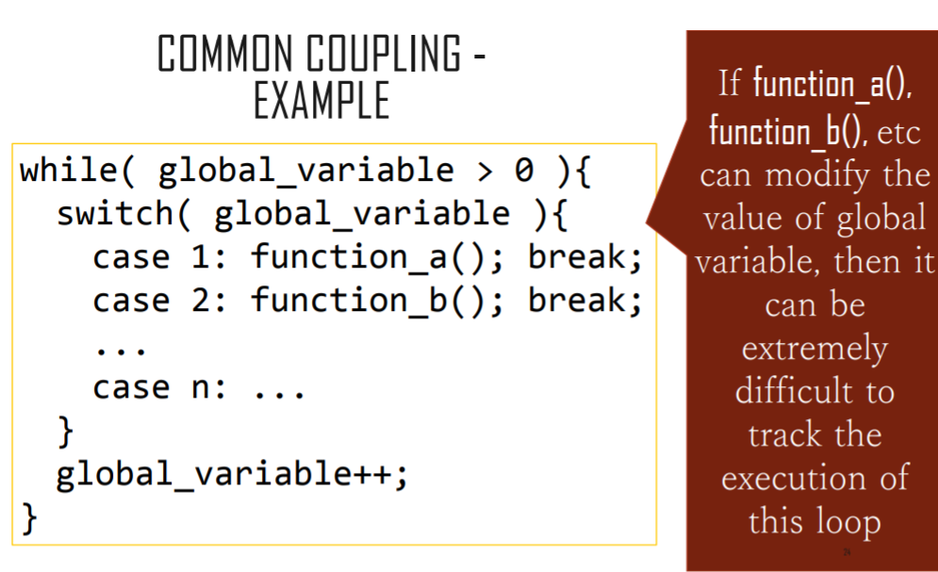

Slide 25
STAMP COUPING
Occurs when too much information is passed to
a function.
typedef struct rectangle
{
int length; int width; int area;
int perimeter; int color; double diagonal; char symbol;
} RECTANGLE;
RECTANGLE CalcArea(RECTANGLE r)
{
r.area = r.width*r.length;
return r;
}
We are passing an entire RECTANGLE to this function, even though the function really does not need to see or modify all of the members.

Slide 26
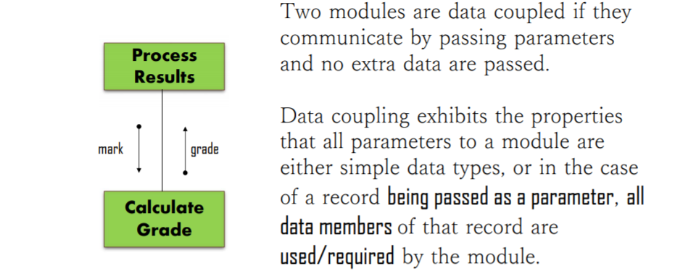
DATA COUPLING

Slide 27

DATA COUPLING – MORE EXAMPLE
typedef struct rectangle
{
int length; int width; int area;
int perimeter; int color; double diagonal; char symbol;
} RECTANGLE;
int CalcArea(int width, int length)
{
int area;
area = width*length; return area;
}
This is a better way to write the previous program. Here we will be passing and returning only primitive data types. They are all that is really needed by the functions and now the functions are more general, too.

Slide 28
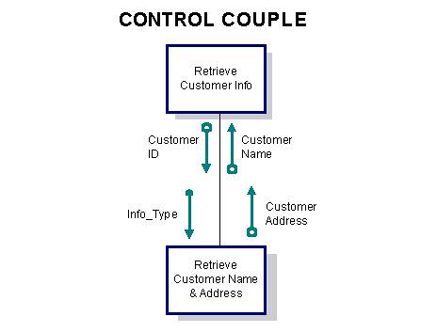
Control Coupling
Control coupling- One module controlling the flow of another, by passing it information on what to do (e.g., passing a what-to-do flag).

Slide 29
COHESION
The manner and degree to which the tasks performed by a single software module are related to one another.
Measures how well design units are put together for achieving a particular tasks.

Slide 30
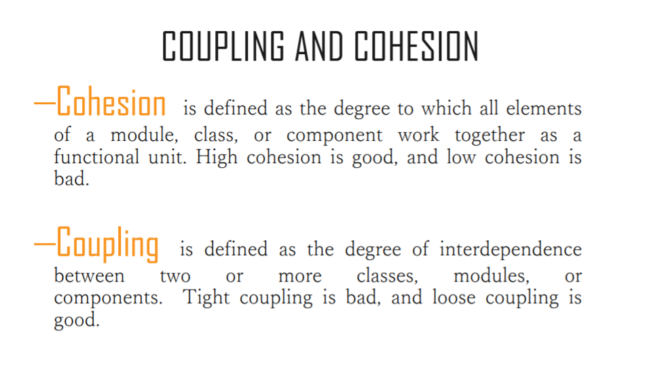

Slide 31
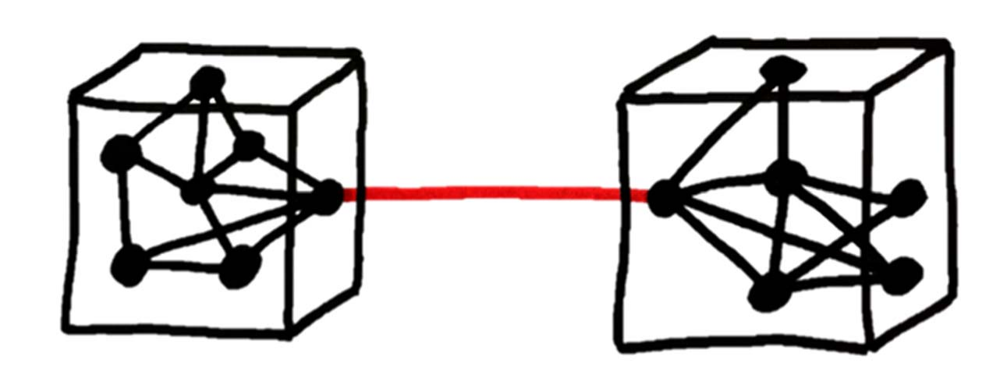
LOOSE COUPLING - HIGH COHESION
In essence, high cohesion means keeping parts of a code base that are related to each other in a single place. Low coupling, at the same time, is about separating unrelated parts of the code base as much as possible.

Slide 32
TYPES OF COHESION

Slide 33
FUNCTIONALCOHESION
•
•
•
A functionally cohesive module contains elements that all contribute to the execution of one and only one problem-related task.
Examples of functionally cohesive modules are
Calculate net employee salary

Slide 34
A sequentially cohesive module is one whose elements are involved in activities such that
2SEQUENTIAL COHESION
output data from one activity serves as input data to the next.
Eg: Module read and validate customer record


Read record
Validate customer record
Here output of one activity is input to the second

Slide 35
A communicationally cohesive module is one whose elements contribute to activities that use the same input or output data. Suppose we wish to find out some facts about a book
2COMMUNICATIONAL COHESION
For instance, we may wish to




FIND TITLE OF BOOK FIND PRICE OF BOOK FIND PUBLISHER OF BOOK
FIND AUTHOR OF BOOK
These four activities are related because they all work on the same input data, the book, which makes the “module” communicationally cohesive.

Slide 36
Eg: module which produces employee salary report and calculates average salary
2COMMUNICATIONAL COHESION
Produce employee salary report
Employee salary report details
Employee salary table
Calculate average salary
Average salary

Slide 37
PROCEDURAL COHESION
A module has procedural cohesion if all the operations it performs are related to a sequence of steps performed in the program.
For example, if one of the sequence of operations in the program was “read input from the keyboard, validate it, and store the answers in global variables”, that would be procedural cohesion.

Slide 38
Example for Sequential Cohesion : Let us take an example of getting data from database. Below will be steps for this task.
1. Get result set from sql command 2. prepare result set 3. return result set
In this example sequence is followed and each activity's result is input for next activity. If any of the activity is not executed successfully then next activity will not executed.
Example for Procedure Cohesion : Let us take example of above module.
1. create connection string 2. Open connection using SqlConnection class 3. Execute sql command suing SqlCommand 4. Get resultset using SqlDataReader
In this example record is fetched from database. We have to use SqlConnection, SqlCommand, SqlDataReader which is different in terms of functionality. But all of them make a complete procedure to get records from database.

Slide 39
TEMPORAL COHESION
Temporal cohesion is when parts of a module are grouped by when they are processed - the parts are processed at a particular time in program execution (e.g. a function which is called after catching an exception which closes open files, creates an error log, and notifies the user).

Slide 40
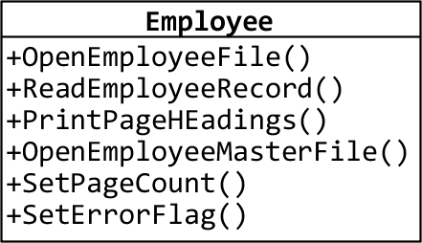
COINCIDENTAL COHESION
This is the weakest form of cohesion. Its element have no meaningful relationship.

Slide 41
Elements of component are related logically and not functionally. • Several logically related elements are in the same component and one of the elements is selected by the client component. Example-1 • A component reads inputs from tape, disk, and network. All the code for these functions are in the same component. • Operations are related, but the functions are significantly different.
LOGICAL COHESION

Slide 42
REFACTORING
Refactoring is a reorganization technique that simplifies the design (or internal code structure) of a component without changing its function or external behavior. It removes redundancy, unused design elements, inefficient or unnecessary algorithms, poorly constructed or inappropriate data structures, or any other design failures.

Slide 43
REFINEMENT
Refinement is actually a process of elaboration. We begin with a statement of function (or description of information) that is defined at a high level of abstraction and reach at the lower level of abstraction. In each step (of the refinement), one or several instructions of the given program are decomposed into more detailed instructions.

Slide 44
REFINEMENT
Abstraction and refinement are complementary concepts. Abstraction enables a designer to specify procedure and data and yet suppress low level details. Refinement helps the designer to reveal low-level details as design progresses.

